Slide 1


Slide 2


Slide 3
Strategic Preparedness for Disaster with DIA

Slide 4


Slide 5
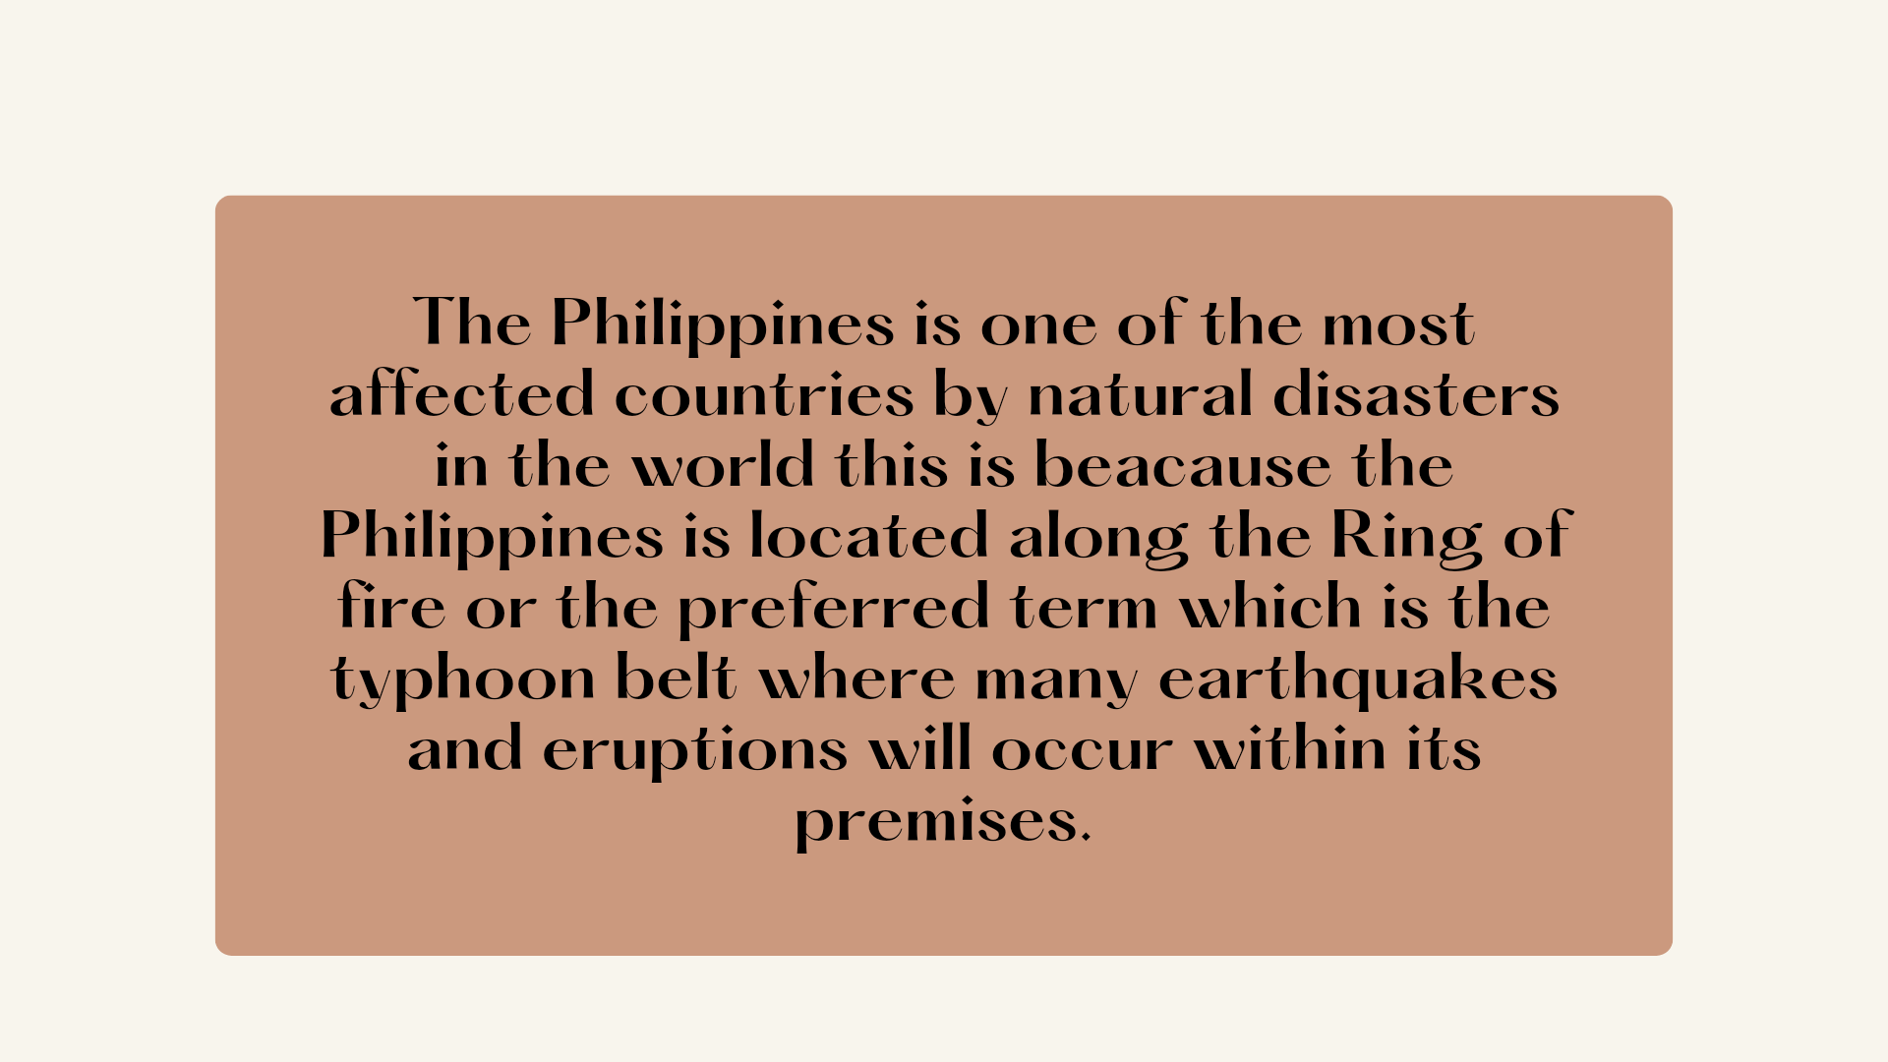

Slide 6


Slide 7


Slide 8
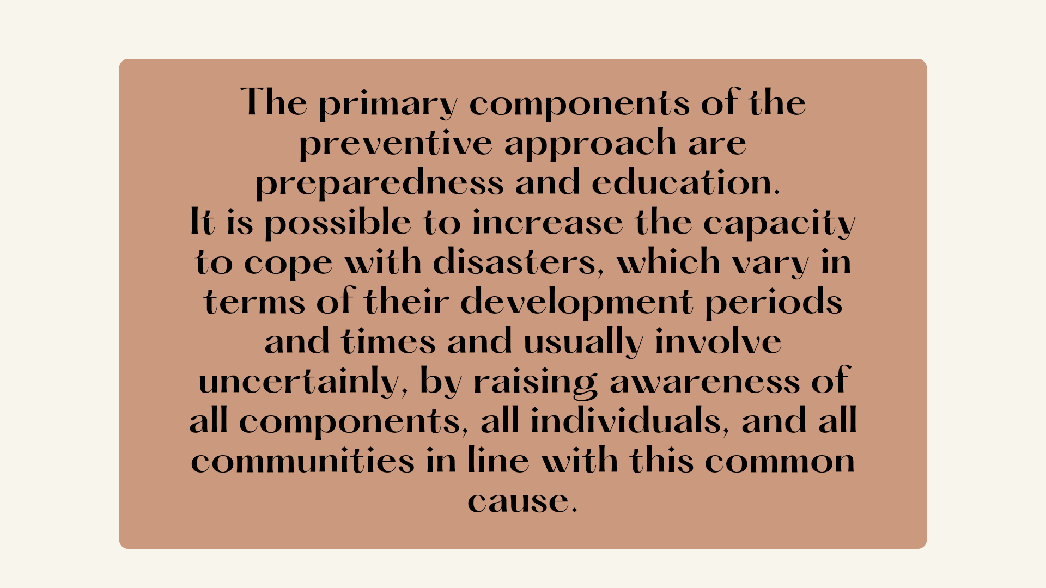

Slide 9


Slide 10
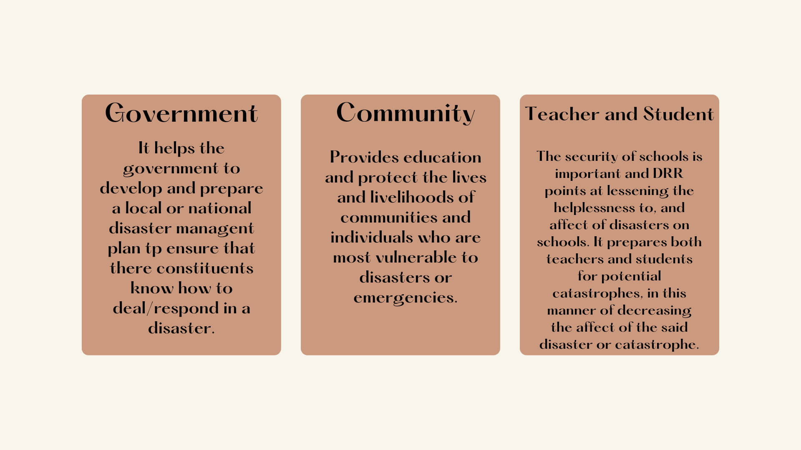

Slide 11
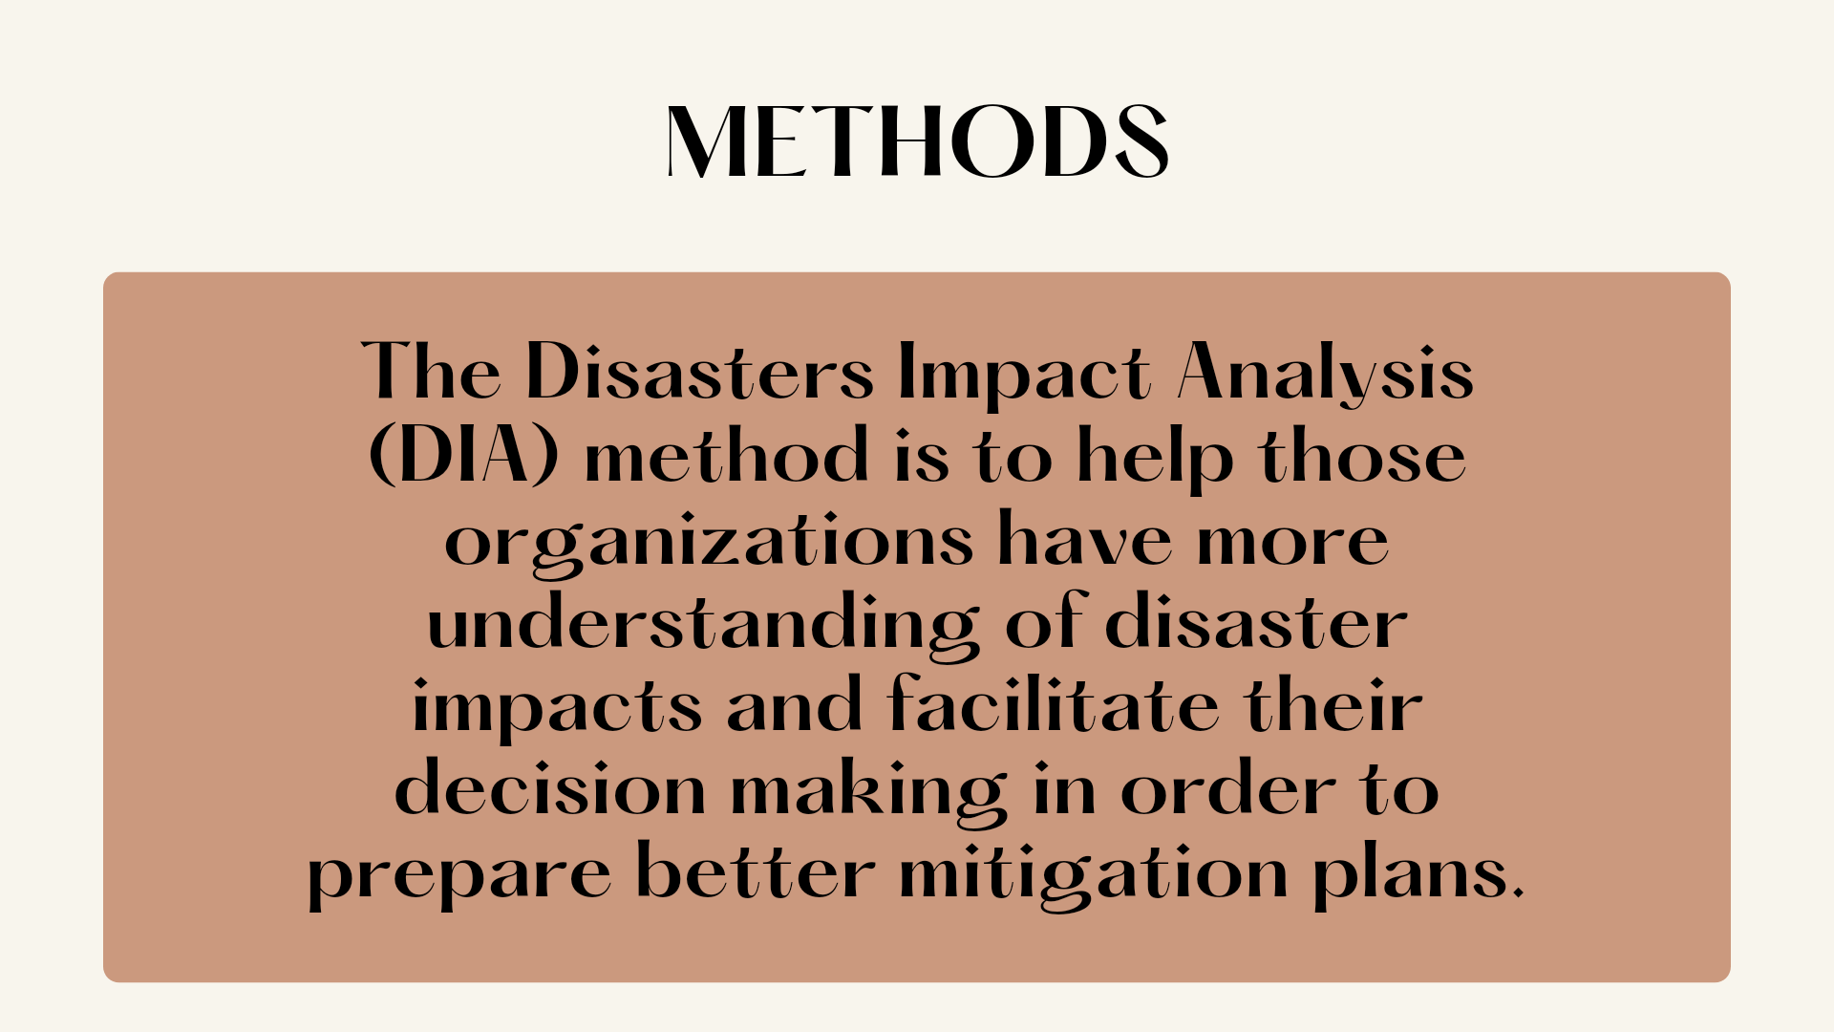

Slide 12
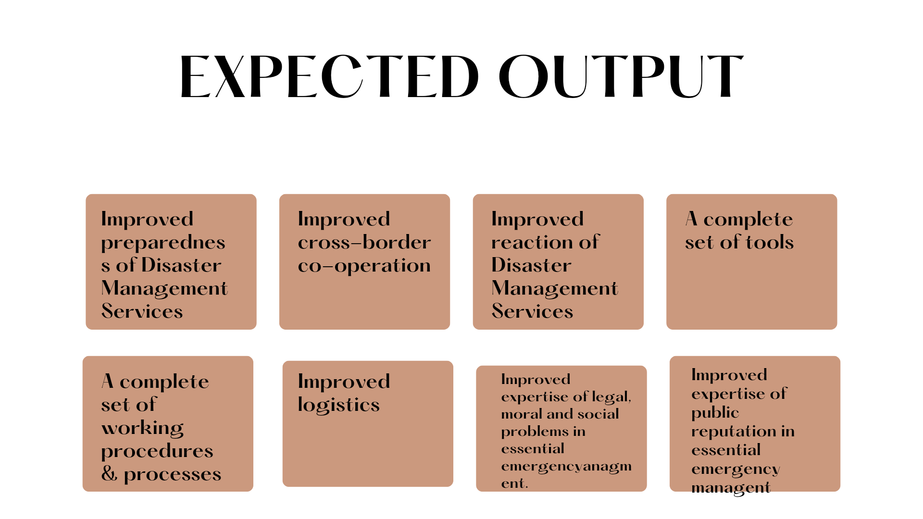

Slide 13
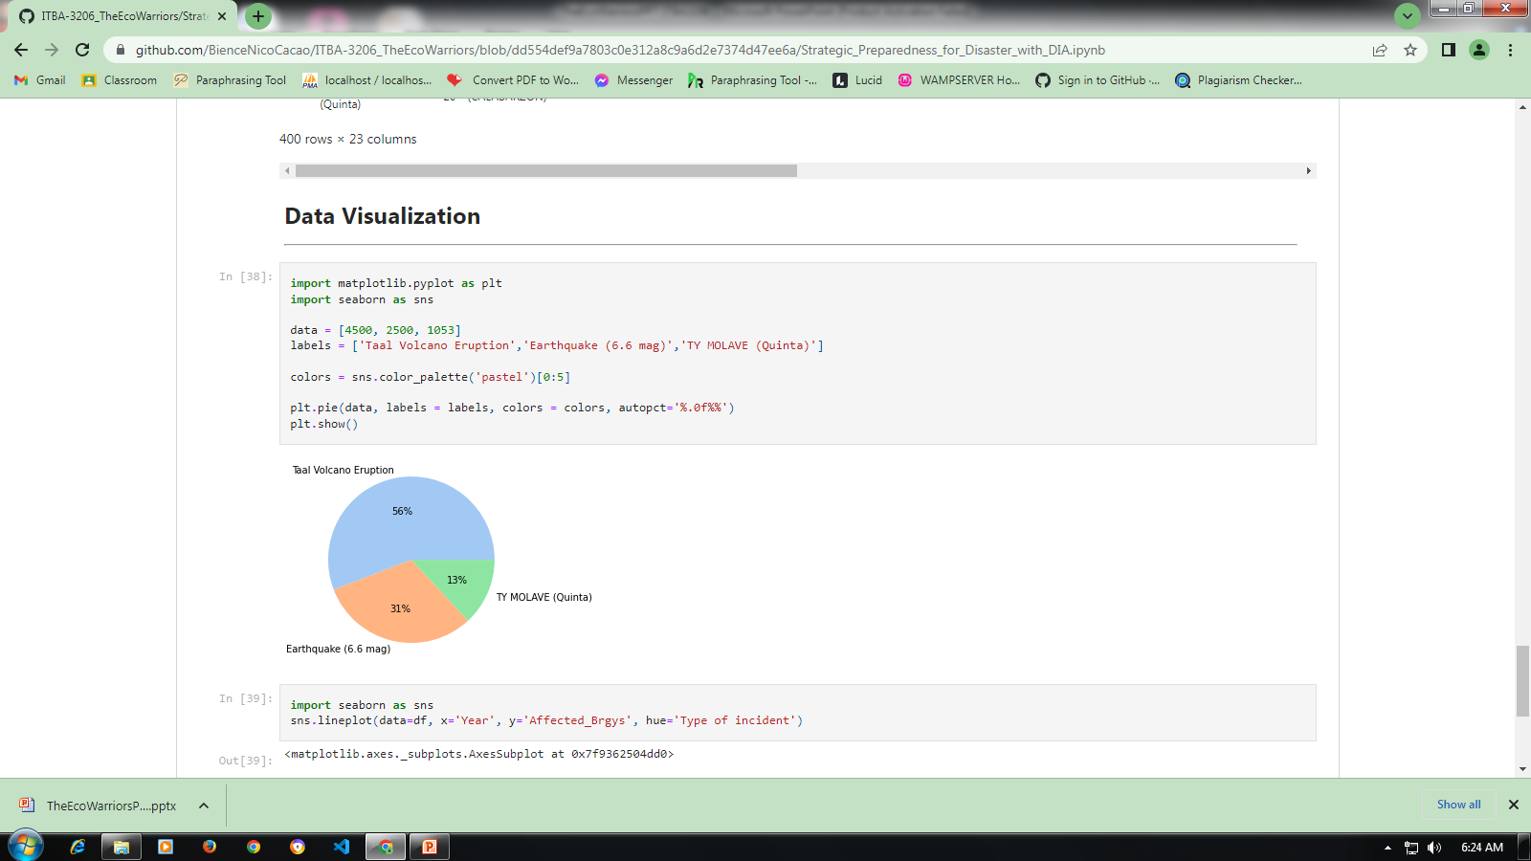
DATA VISUALIZATION
Pie Graph

Slide 14
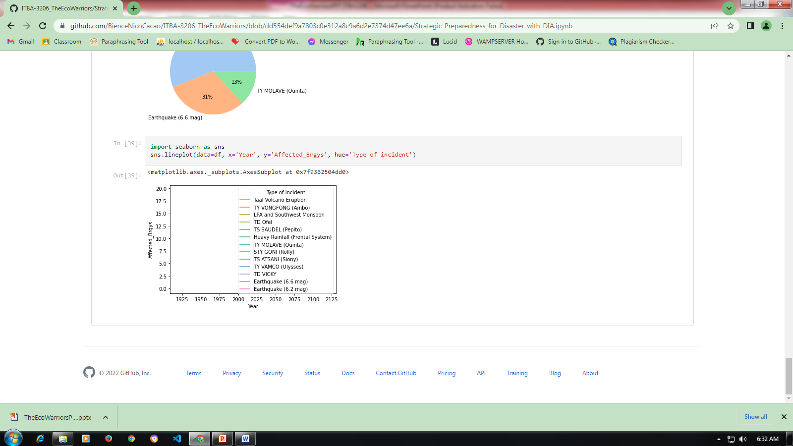
Line Graph

Slide 15


